Slide 1
Perl 6 rules
Radek Kotowicz
2nd Polish Perl Workshop,
Poznań, May 2014

Slide 2
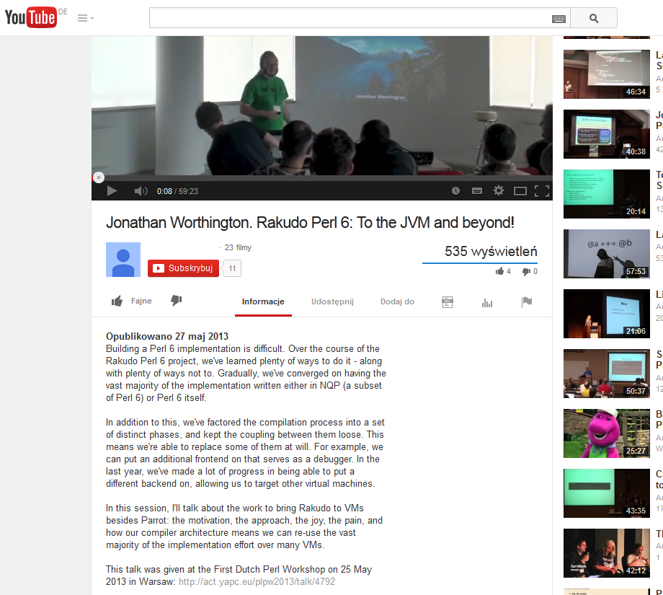

Slide 3
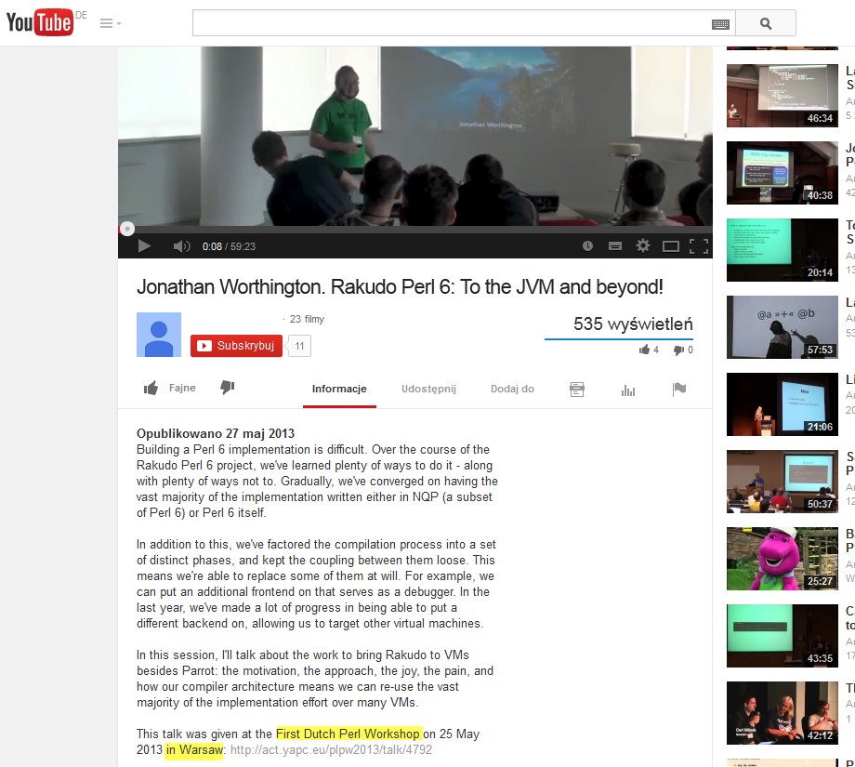

Slide 4
What drives complexity of Perl 5 regex?
Basic regular expressions (describing regular languages) are easy to match: O(|T|) / O(|r|*|T|)
Backreferences:
Exponential time O(2^|T|)
NP-complete problem (3SAT reduction)
implicate the use of backtracking algorithms

Slide 5
…
Look-behind assertions add even more complexity (input is not consumed): O(2^{|T|+|r|})
Experimental features of code assertions introduced undecidability:
a=~/<?{do 1 while 2;}>/

Slide 6
Apocalypse 5
Perl 5 REGEXes were:
too compact and 'cute‘
had too much reliance on too few metacharacters
little support for named captures
little support for grammars
poor integration with the 'real' language

Slide 7
What’s new in Perl 6 rules?
Named captures (backported to 5.10)
Simpler notation for non-capturing groups
White spaces ignored unless backspaced
Simplified code assertions (experimental in 5.18)
New character classes and set operations on char classes

Slide 8
Now the big things
Rules are part of the ‘real’ language (same lexer/parser)
Support for Parsing Expression Grammars (PEGs)
Backtracking/matching control
Code assertions can fail or succeed unlike in Perl 5
$perl -e "'abrakadabra'=~/(ab)(?{0}).*(?{print 'OK'})/“
OK
$perl6 -e "'abrakadabra'~~/(ab)<?{0}>.*<?{say 'OK'}>/“

Slide 9
PEGs
Similar to CFG but unambiguous in terms of parse trees
CFG rules explain how to produce words – PEGs explain how to parse them:
CGF for {a^{n} b^{n} : n >=1}:
S -> 'a' S 'b‘
S -> ε
PEG
S ← 'a' S? 'b'
PEG: negative/positive look-ahead assertions

Slide 10
…
With PEGs it’s possible to describe some non-context-free grammars {a^{n} b^{n} c^{n} : n >=1}
Recognizing PEG expressions can be done in linear time if there’s enough memory
Rakudo comes with a JSON parser implementation written in Perl 6 rules!
Naturaly, Perl6 grammar is also expressed in PEG

Slide 11
Exploratory parsing
grammar BookGrammar {
rule TOP {<book>+}
regex book {<author><whitespace><title> | <title><whitespace><author>}
regex author { (<name>|<initial>) [<whitespace>[<name>|<initial>]]? <whitespace> <surename> }
rule name {(<word>)<?{ %firstNames{$0}:exists}>}
rule surename {<word>}
rule title { '"'<word>[<whitespace><word>]*'"'}
token word { <alpha>+ }
token initial { <alpha>\.? }
token whitespace {\s+}
}

Slide 12
…
sub MAIN() {
my $match = BookGrammar.parse('Joseph Conrad "Lord Jim"');
say $match;
}

Slide 13
…
Joseph Conrad "Lord Jim""
book => "Joseph Conrad "Lord Jim""
author => "Joseph Conrad"
0 => "Joseph"
name => "Joseph"
0 => "Joseph"
word => "Joseph"
alpha => "J"
alpha => "o"
alpha => "s"
alpha => "e"
alpha => "p"
alpha => "h"
whitespace => " "
surename => "Conrad"
word => "Conrad"
alpha => "C"
alpha => "o"
alpha => "n"
alpha => "r"
alpha => "a"
alpha => "d"
whitespace => " "
title => ""Lord Jim""
word => "Lord"
alpha => "L"
alpha => "o"
alpha => "r"
alpha => "d"
whitespace => " "
word => "Jim"
alpha => "J"
alpha => "i"
alpha => "m"

Slide 14
use Grammar::Tracer
C:\Users\I079489\projects\plpw2014>c:\rakudo\bin\perl6.exe parse_books.pl
←[1mTOP←[0m
| ←[1mbook←[0m
| | ←[1mauthor←[0m
| | | ←[1mname←[0m
| | | | ←[1mword←[0m
| | | | | ←[1malpha←[0m
| | | | | * ←[37;42mMATCH←[0m←[37m "J"←[0m
| | | | | ←[1malpha←[0m
| | | | | * ←[37;42mMATCH←[0m←[37m "o"←[0m
| | | | | ←[1malpha←[0m
| | | | | * ←[37;42mMATCH←[0m←[37m "s"←[0m
| | | | | ←[1malpha←[0m
| | | | | * ←[37;42mMATCH←[0m←[37m "e"←[0m
| | | | | ←[1malpha←[0m
| | | | | * ←[37;42mMATCH←[0m←[37m "p"←[0m
| | | | | ←[1malpha←[0m
| | | | | * ←[37;42mMATCH←[0m←[37m "h"←[0m
| | | | | ←[1malpha←[0m
| | | | | * ←[37;41mFAIL←[0m
| | | | * ←[37;42mMATCH←[0m←[37m "Joseph"←[0m
| | | * ←[37;42mMATCH←[0m←[37m "Joseph"←[0m
| | | ←[1mwhitespace←[0m
| | | * ←[37;42mMATCH←[0m←[37m " "←[0m
| | | ←[1mname←[0m
| | | | ←[1mword←[0m
| | | | | ←[1malpha←[0m
| | | | | * ←[37;42mMATCH←[0m←[37m "C"←[0m
| | | | | ←[1malpha←[0m
| | | | | * ←[37;42mMATCH←[0m←[37m "o"←[0m
| | | | | ←[1malpha←[0m
| | | | | * ←[37;42mMATCH←[0m←[37m "n"←[0m
| | | | | ←[1malpha←[0m
| | | | | * ←[37;42mMATCH←[0m←[37m "r"←[0m

Slide 15
That’s it

Slide 16
Thank you!

